Slide 1
BY DOMINGOS DESIGN & MEDIA
IL7 SECURITY
Security by DESIGN
Security by PROCESS
Security in PRACTICE

Slide 2
IL7 SECURITY
STRUCTURED WORKSHOP
STRUCTURED WHAT IF
WHAT IF THIS, WHAT IF THAT
SWIFT
Security by DESIGN
Security by PROCESS
Security in PRACTICE

Slide 3
IL7 SECURITY
RISK DISCOVERY
Principles of effective risk management approaches Through examining the three sample projects in detail, NCSC identified eight fundamental principles of effective approaches to risk management:
Accept there will always be uncertainty
Make everyone part of your delivery team
Ensure the business understands the risks it is taking
Trust competent people to make decisions
Security is part of every technology decision
User experience should be fantastic - security should be good enough
Demonstrate why you made the decisions - and no more
Understand that decisions affect each other

Slide 4
IL7 SECURITY
RISK DISCOVERY
Risk Discovery is a Project – Main Stakeholder Buy In is crucial
Timeline:
Interview with Principal Stakeholders
Workshop to discover business context / value of assets
Systems, Users, Locations
What if this / that analysis
Workshop to examine Threats and probabilities
Document and Produce Security Case
Distribute draft for comment
Present finished Document to Stakeholders

Slide 5
Calculating Risk – SWIFT Methodology on a SLIDE
Risk is a function of Consequence (impact) and Probability
Review value of the information assets to the business : measure the impact of loss for each asset, in terms of confidentiality, integrity and availability. Mark each out of five where 5 equals the worst case.
Probability is based on the capability of a compromised / motivated attacker, and the opportunity to attack which will depend on the controls or lack of in place and vulnerabilities. Review those controls in place against a basic set of best practices. Based on a consensus view mark the probability against each potential attacker out of 5.
Confirm technical vulnerability with an ITHC which constitutes a review of system configuration against best practice and if relevant a penetration test to expose vulnerabilities. Any vulnerabilities that cannot be immediately treated increase the opportunity of the attacker and the probability of attack. If no ITHC whiteboard it in a workshop.
Risk is then calculated as a function: Risk = Impact x Probability
Any Risk at 10 or above needs to be treated. Treatment involves a decision to either mitigate the risk with a control (Physical, Personal, Procedural or Technical), to transfer it through insurance or to tolerate the risk. The latter must be accompanied by a risk balance case. This activity will result in a Risk Treatment Plan (RTP) where all activities promised are constrained by an owner and proposed timescale.
The RTP and its management need to be acceptable to the Assurance Authority to gain an Authority to Operate.

Slide 6
SWIFT Workshops
Allow you to focus on the Stakeholders
You can address any technology IT, OT
Can look at:
Safety
Compliance
Financial Risk
Operational Risk
Personal Information - GDPR

Slide 7
TOC RISK WORKSHOP
TOPICS TO
COVER
Assurance Scope – Business Context
Risk Appetite – Business Opportunity
Assets – Impact to CIA of a breach
Threat Sources FIS Terror Crime
Threat Actors – Insider, Outsider
Likelihood – Motivation of Compromised Threat Actors
Capability (Vulnerabilities, Access, Opportunity)
Prioritise the Risks
Get consensus and document

Slide 8
IL7 SECURITY CONSULTANTS
THE TOC – IT & OT
Context
Business Objectives
Essential System
Information Technology
Communications
Operational Technology
Examine existing Controls
Physical Security
Procedural Security - SyOps & SOP
Personal Security – Vetting etc
Technical controls – patching, encryption, hardening, monitoring, back-up etc.

Slide 9
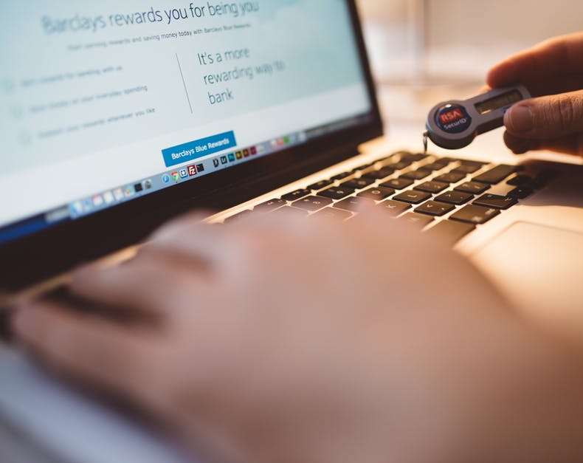
IL7 SECURITY CONSULTANTS
ASSURANCE SCOPE
Systems to be included
Business Sites to be included:
Stations
Depots
Offices
Connectivity
Data Centres
End User Devices

Slide 10
IL7 SECURITY CONSULTANTS
ASSETS AT RISK
Personal Information
Financial / Commercial / IPR
Performance Information
general
specific
Incidental Information
of systems in scope, i.e.
Host names
IP address
Configuration
Vulnerabilities
Critical Systems
Voyage Planning
Train Maintenance
Voyage Operations
Crew Planning
Finance / Ticketing
Pay Systems
Passenger Information
ASSETS AT RISK

Slide 11
IL7 SECURITY CONSULTANTS
ASSET SCORE 1-5 WHERE CONSEQUENCE of 5 = HIGH IMPACT
Asset / System | Confidentiality | Integrity/Availability | Safety | HIGHEST IMPACT
Voyage Planning
Crew Planning
Train Maintenance
PIS
Comfort Systems
Ticketing
Payroll
Signalling

Slide 12
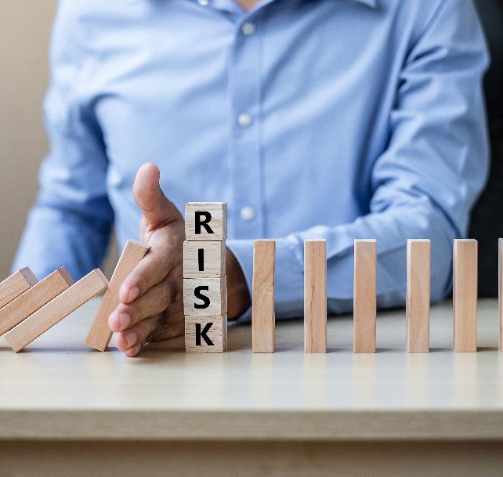
IL7 SECURITY CONSULTANTS
RISK
&
RISK APPETITE
SO WHAT IS RISK APPETITE?
Opportunity Risk
Business Risk
Minimalist
Cautious
Open
Hungry
Benefits to the Operating Company
Reduce costs of maintenance
Increase productivity
.
Operational Risk, Financial Risk, Compliance Risk, Reputational Risk, Competitive Risk

Slide 13
IL7 SECURITY CONSULTANTS
THREAT
SOURCES
Foreign Intelligence Services
Terrorist Organisations
Organised Crime
Cyber Hackers (for their own purposes)
Hacktivists
Investigative Journalists
Political Activists
Unhappy Users – disgruntled, disaffected

Slide 14
IL7 SECURITY CONSULTANTS
THREAT ACTORS
System Users / Network Users
System / Network Administrators
Bystanders – Visitors, Cleaners, Maintenance staff
Physical Intruders
Hackers – internal / external
Criminal Hacking Groups
State Sponsored Attacks
Terrorism
Vandalism
Political Interest Groups

Slide 15
IL7 SECURITY CONSULTANTS
TYPES OF
CYBER THREAT
DDOS – Denial of Service
Cyber Attack on CIA
Injection
XSS
Buffer Overflow
Man in the Middle
OWASP
Attack on Cyber HQ
Phishing
Whaling
Ransomware, monitoring, back-up.

Slide 16
IL7 SECURITY CONSULTANTS
THREAT ACTORS – SCORE 1-5 WHERE HIGH IS 5 = PROBABILITY
Threat Actor | Opportunity | Capability | Priority / Intent | Summary Probability
IT Administrator
IT Analyst
Bystander / Visitor
Supplier Sub-Con
System Providers
Hacker (internet)
Shared System Subscriber
Physical Intruder

Slide 17
IL7 SECURITY CONSULTANTS
SWOT –
CYBER ATTACKER
Strengths
Tools from dark web
Weaknesses
Outside FW (need ITHC)
Opportunities
Vulnerabilities in config.
Unpatching SEF
Threats
DDOS, Intrusion, OWASP, Phishing, Ransomware
Additional Controls –
Physical, Procedural, Personal, Technical

Slide 18
IL7 SECURITY CONSULTANTS
SWOT –
INSIDER THREAT
Strengths
Close to the fruit
Weaknesses
Need Id & A, work to SOPs, Playbooks
Opportunities
Unsupervised access
Threats
Disclosure, destruction
Additional Controls –
Physical, Procedural, Personal, Technical

Slide 19
Calculating Risk – SWIFT Methodology on a SLIDE
Risk is a function of Consequence (impact) and Probability
Review value of the information assets to the business : measure the impact of loss for each asset, in terms of confidentiality, integrity and availability. Mark each out of five where 5 equals the worst case.
Probability is based on the capability of a compromised / motivated attacker, and the opportunity to attack which will depend on the controls or lack of in place and vulnerabilities. Review those controls in place against a basic set of best practices.
Conduct IT Health Check which constitutes a review of system configuration against best practice and if relevant a penetration test to expose vulnerabilities. Any vulnerabilities that cannot be immediately treated increase the opportunity of the attacker and the probability of attack.
Risk is then calculated as a function: Risk = Impact x Probability
Any Risk at 10 or above needs to be treated. Treatment involves a decision to either mitigate the risk with a control (Physical, Personal, Procedural or Technical), to transfer it through insurance or to tolerate the risk. The latter must be accompanied by a risk balance case. This activity will result in a Risk Treatment Plan (RTP) where all activities promised are constrained by an owner and proposed timescale.
The RTP and its management need to be acceptable to the Assurance Authority to gain an Authority to Operate.

Slide 20
IL7 SECURITY CONSULTANTS

