Slide 1
The ThamesLink Programme (TLP)
Department for Transport
Network Rail - signalling
Siemens Class 700 Train
GTR – train and fleet management
Target
24 trains per hour across London – each way

Slide 2
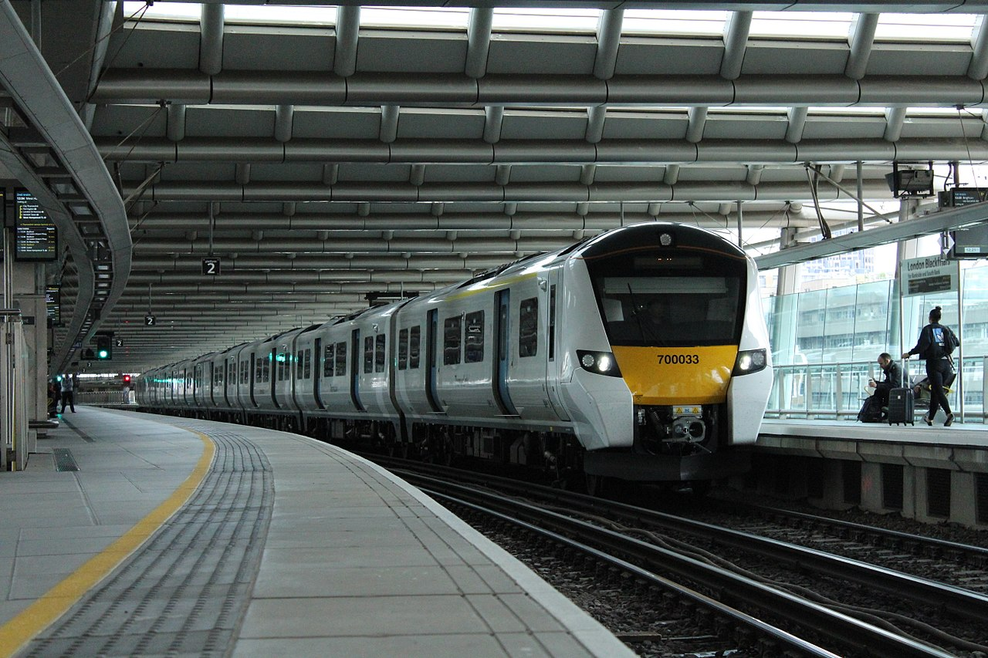

Slide 3
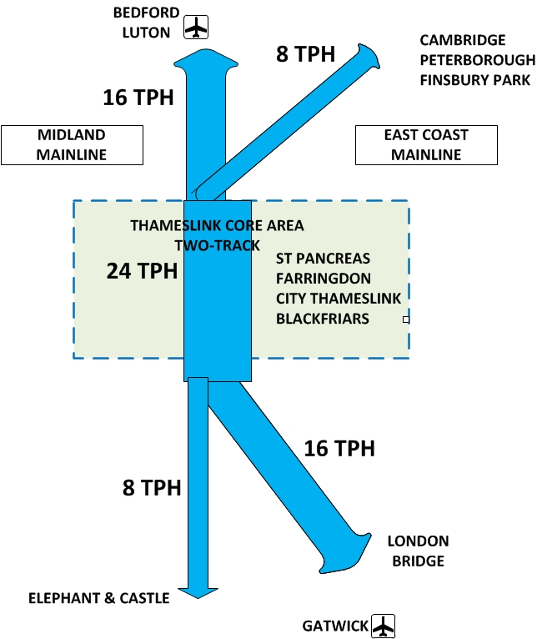
Note – TPH = trains per hour and that is …….each way

Slide 4
Thameslink Partnership Alliance / Reliance The CYBER Threat
Could the C700 be hacked?
GSM-R was compromised by UKRRIN Digital at Birmingham University
Could the Network Rail “Radio Block Control (RBC)” be interfered with.
Could the ETCS or EVC be hacked on the train in operation?
Could malicious code be entered during routine maintenance?
Could an insider at the Rail Operations Centre be compromised through bribery, threat or corruption?

Slide 5
Thameslink Partnership Alliance / Reliance The CYBER IMPACT
What happens if a Train is Hacked?
Its Movement Authority is corrupted
It goes faster or slower than it is supposed to
It is late or early
It causes delay and disruption
Customer Confusion
Reputational Damage
Even Loss of Life

Slide 6
My Investigations So Far
Meetings with Pen Test Partners to discuss their attacks on SCADA.
Meetings with Razor Secure to discuss their views on protecting trains in-flight.
Meetings with UKRRIN at Birmingham University.
GTR Questions to Siemens about Security Testing.
Examination of Siemens ISO 27001 Statement of Applicability
In German, lack of detail on testing, did not cover maintenance environment.
Workshop of TLP CSWG - inconclusive
Visual Inspection of C700 instrumentation (4th October 2018).

Slide 7
Recommendations / Next Steps
Press for more documentation from Siemens.
ISO 27001 for maintenance and EVC monitoring against cyber.
Examine Procedures for Key management for GSM-R at GTR
Note G3 used – can we wait for G5
Examine Potential for Pen Testing C700 rolling stock by GTR / PTP
Not much appetite – awaiting review by GTR Director of Engineering
Examine potential for C700 tests byUKRRIN at Birmingham
They have funding from Siemens and a mock up C700 at the Uni.
Depending on the above look at Protective monitoring
Possibly RazorSecure or explore Scada market place.
More Collaboration – Definitely!!!!
Incident Practice ? – Assurance it can be handled
Final risk assessment (RMADS or scenario based ?) presentation to DfT.

